Slide 1
ART BIBLE
Art Bible for the UniSA VR Project

Slide 2
Content
ART REFERENCES
CONCEPT ART/GREY-BOXES
TECHNICALS

Slide 3
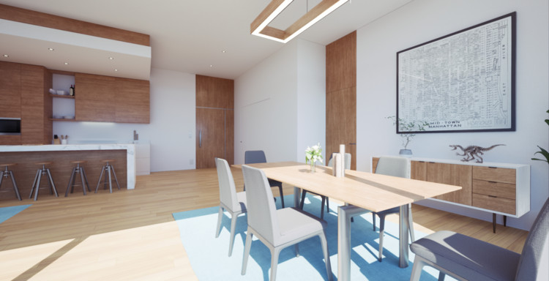
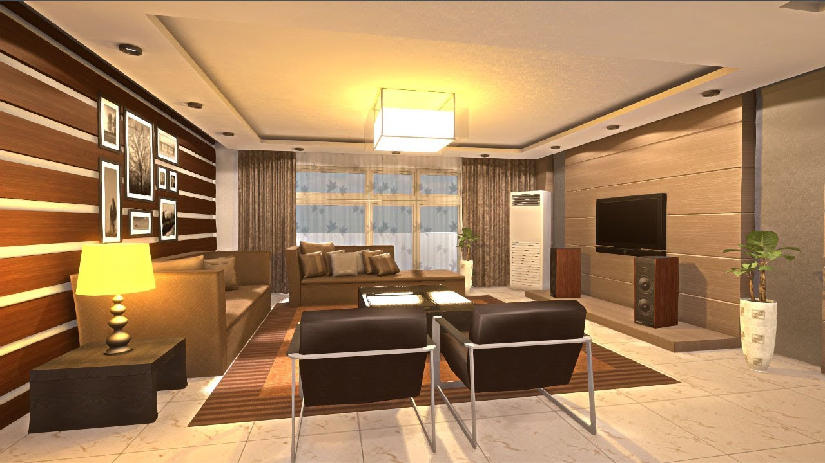
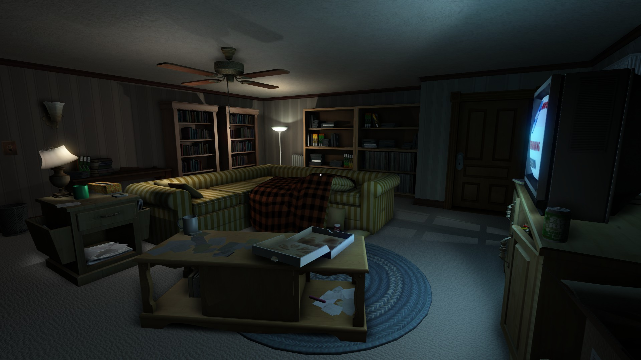
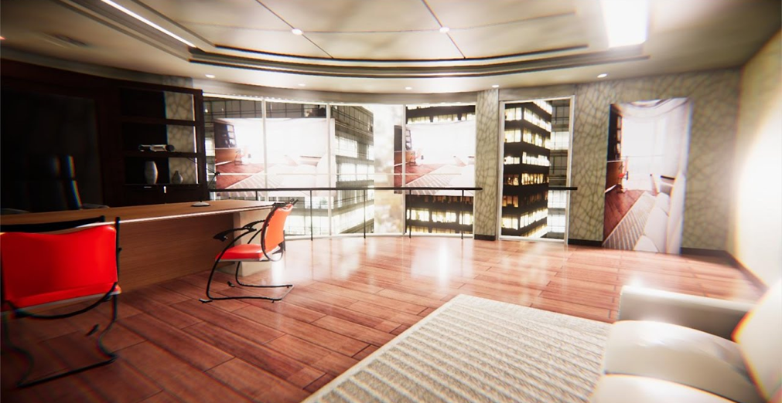
Art Reference
Art Style: The art style should adhere to a realistic standard, attempting to mimic a real-world feel.

Slide 4
360 Videos YouTube Links
Bedroom: https://www.youtube.com/watch?v=sBVv5JWr4M0&feature=youtu.be&fbclid=IwAR26wn8DUNjT9K3496MemE6Gz2ABdwuUlE6IdG-84P0fbbAQwyQ7fd9gkL4
Living Room: https://www.youtube.com/watch?v=Lluuy3pmwhg&feature=youtu.be&fbclid=IwAR3paeZNAo35g-0IynaQcseAVHKbjRU0otGYGJm4DWcmrI5OtwumdKijkbk
Kitchen: https://www.youtube.com/watch?v=Oi0f0dQslzk&feature=youtu.be&fbclid=IwAR2pZVwDFZL1J8REv5_XU8QRnqi82BNinaU_OzNXc1afddJs3dAMj56bK7Y

Slide 5
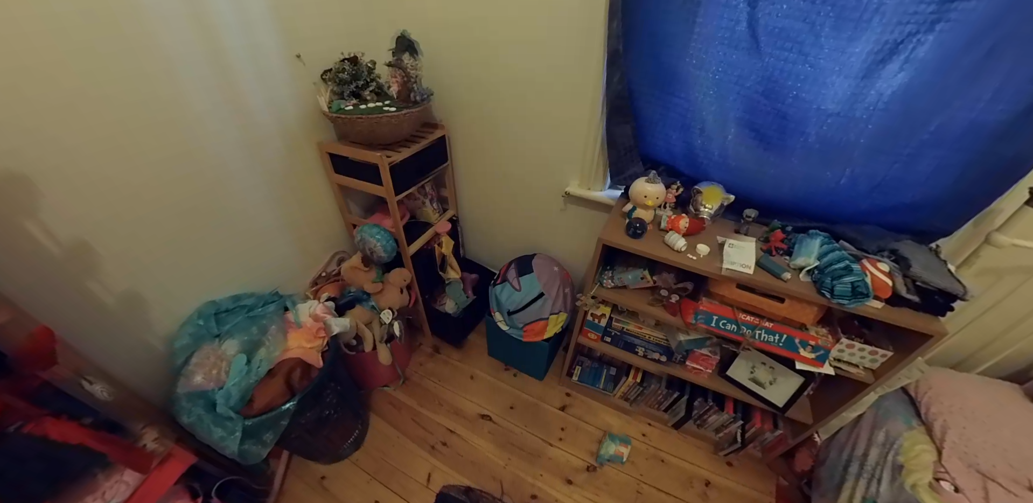
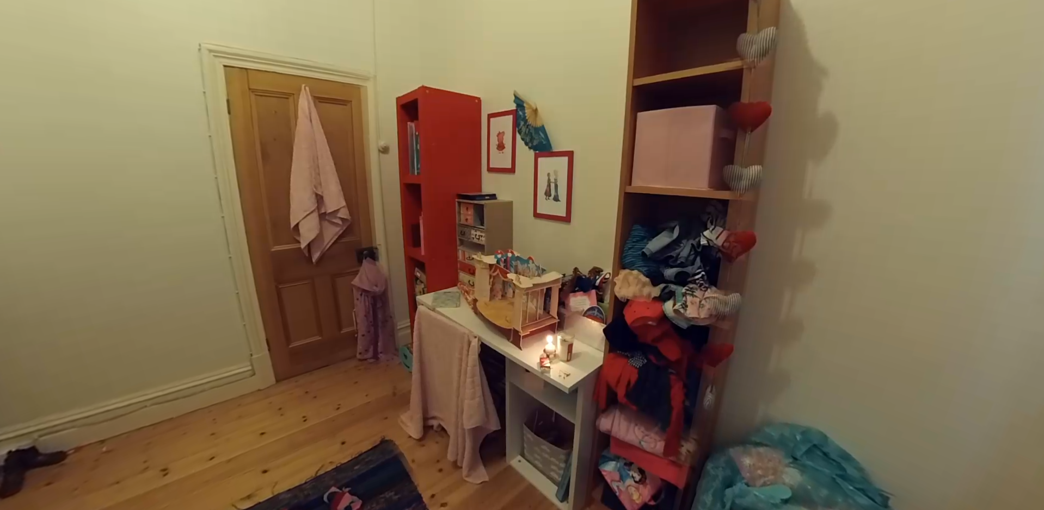
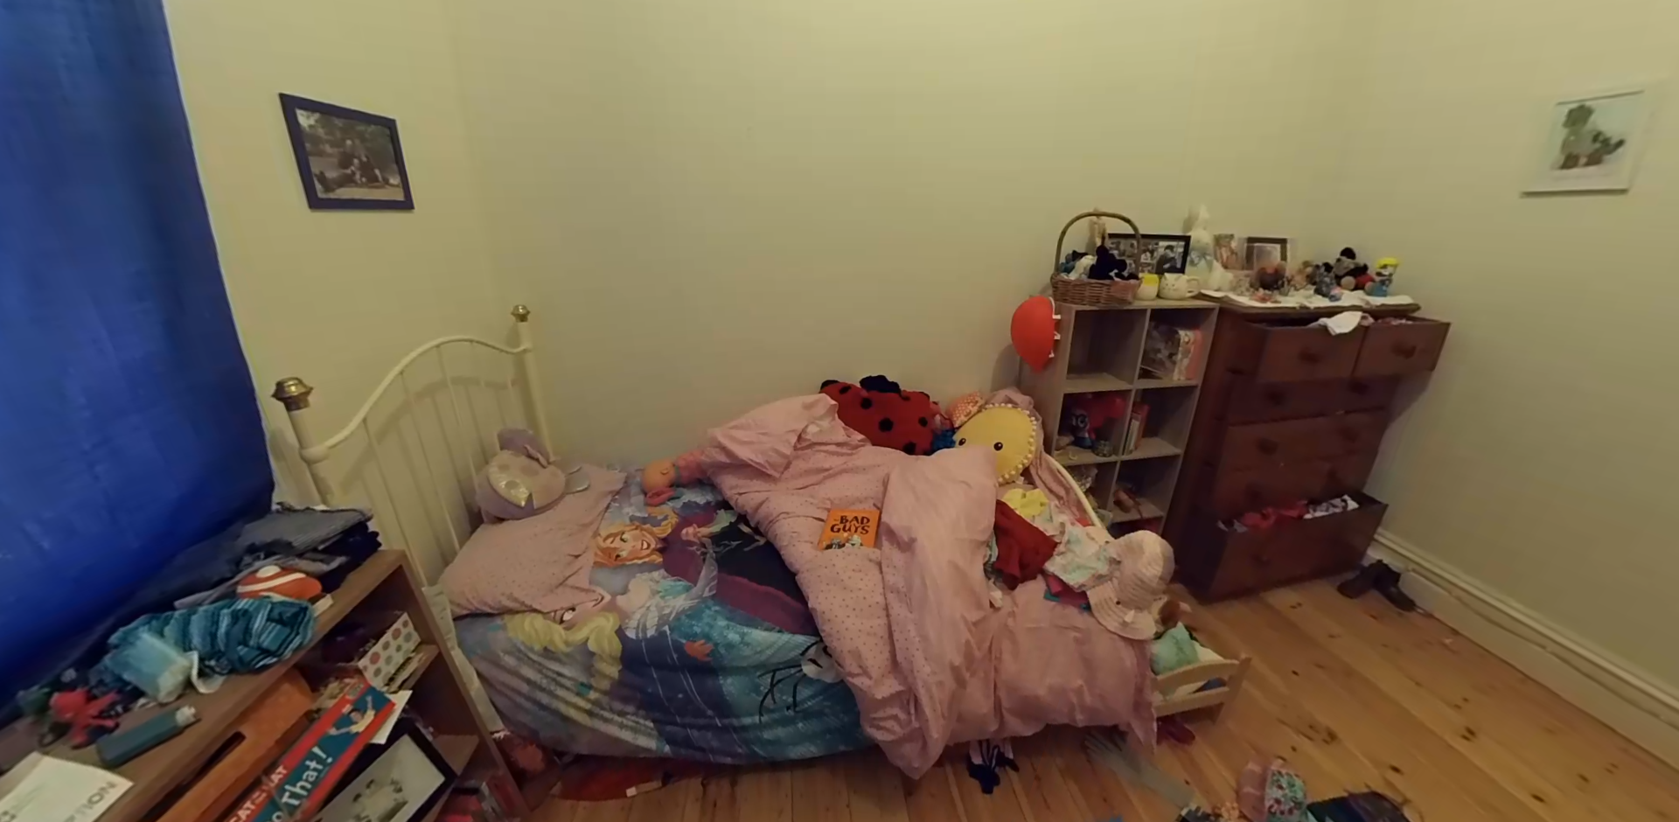
360 Bedroom Stills

Slide 6
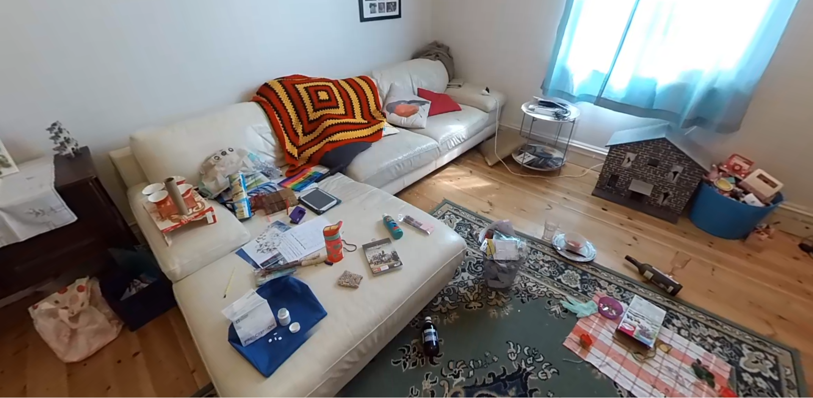
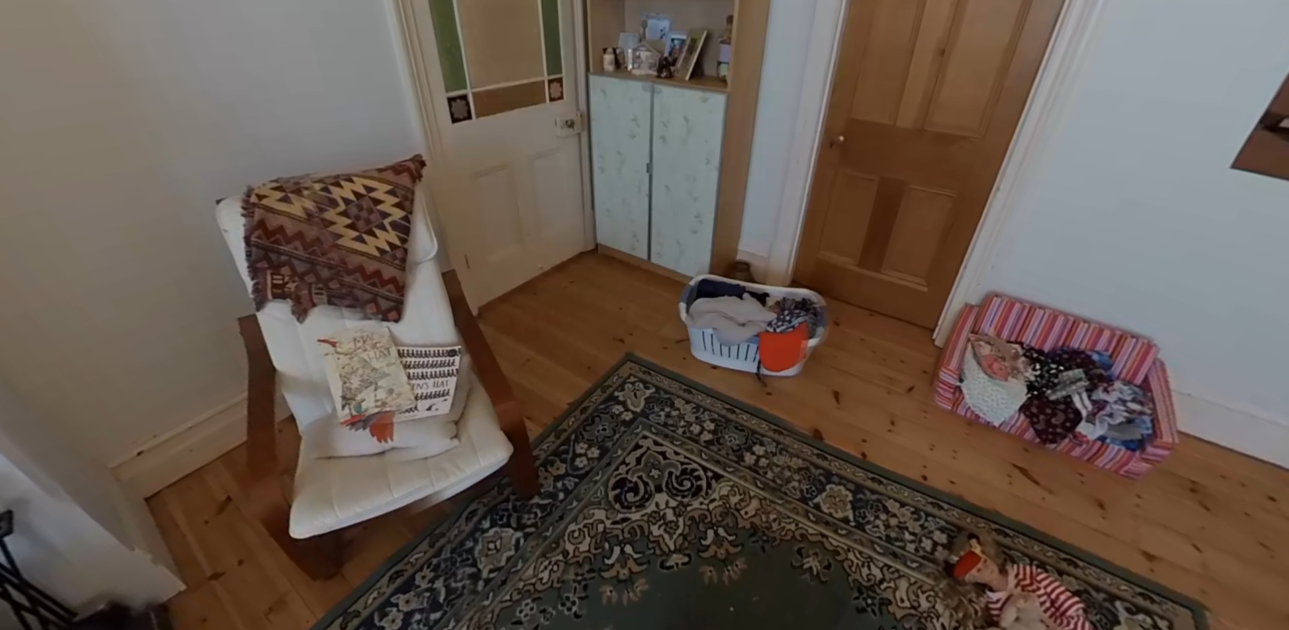
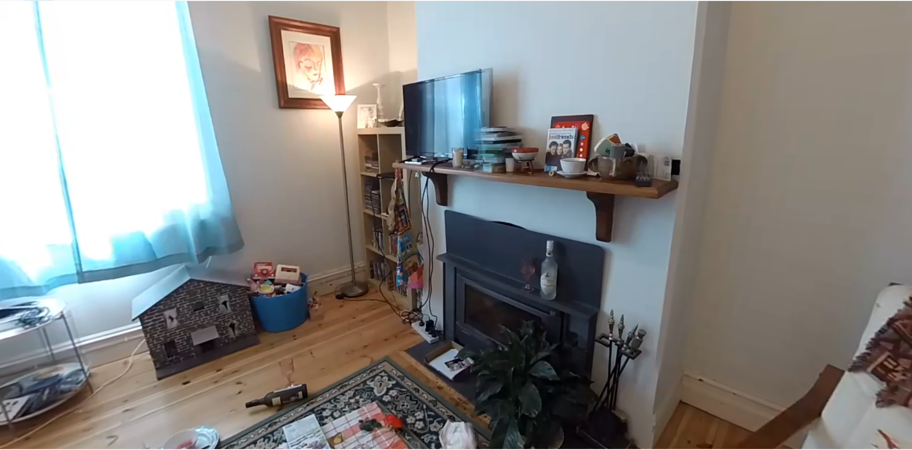
360 Living Room Stills

Slide 7
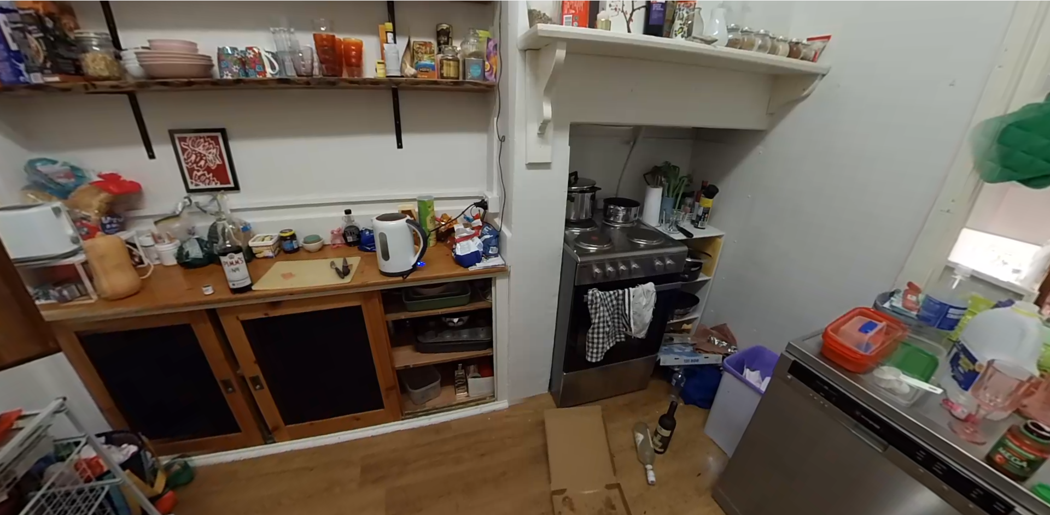
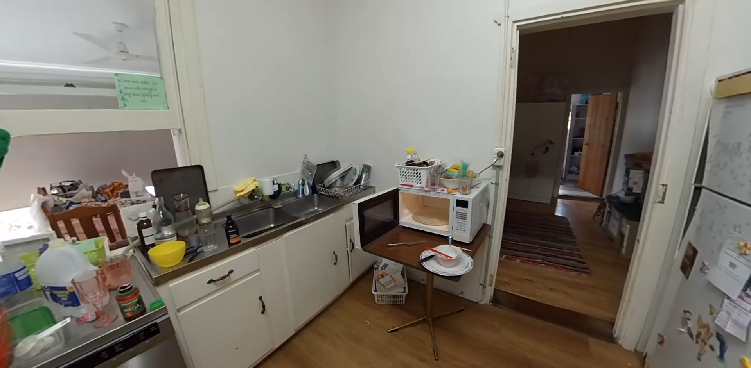
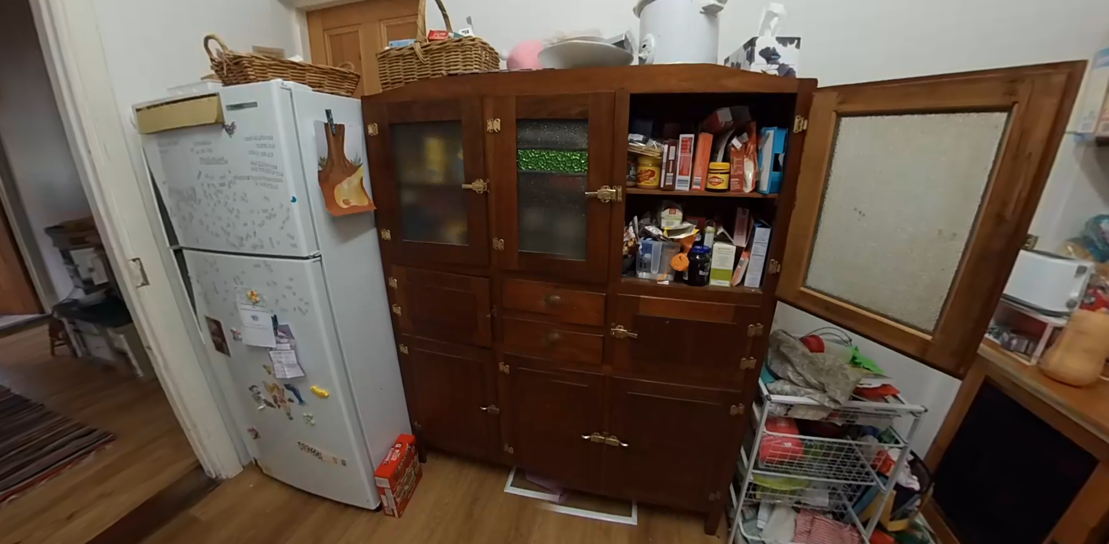
360 Kitchen Stills

Slide 8
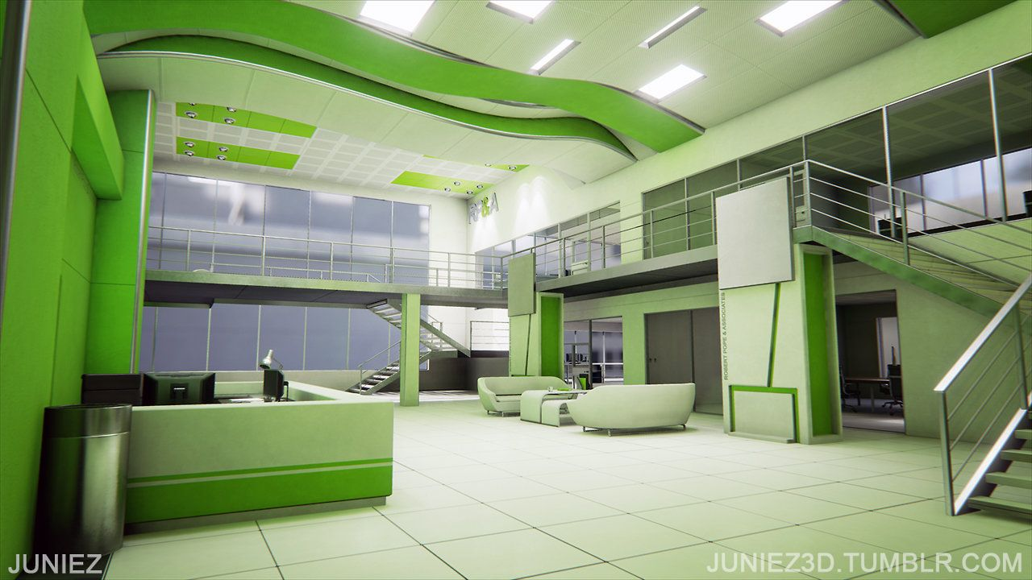
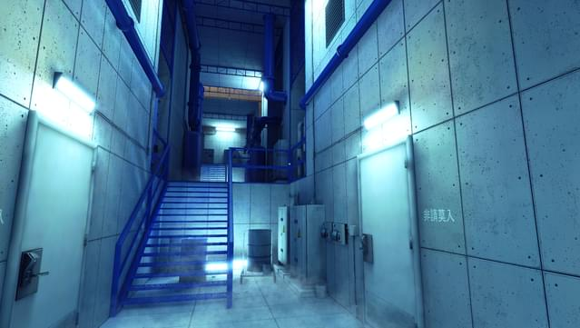
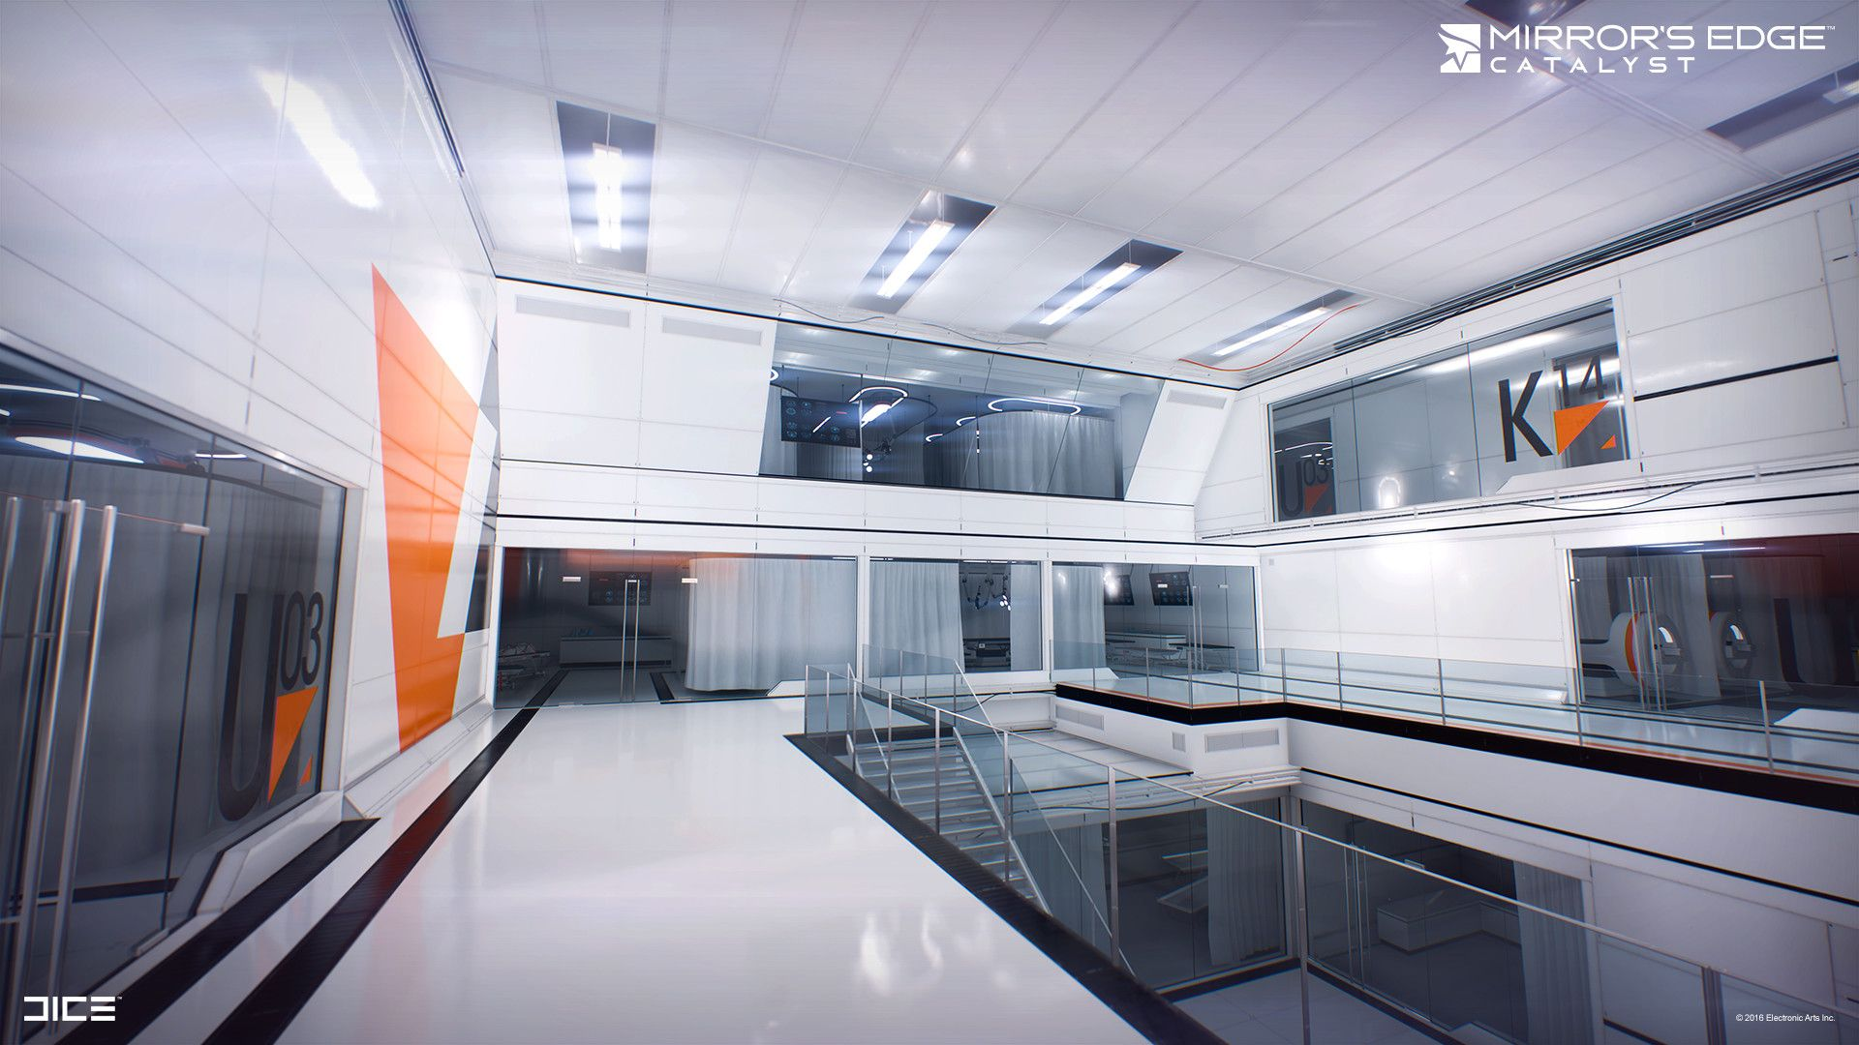
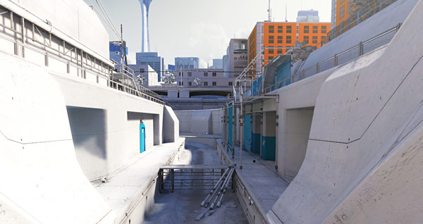
Reference: Mirror’s Edge
Mirror’s Edge is used for reference for its realistic form and construction of assets. The texture style contains very vivid colours, this is not to be replicated for the VR assets.

Slide 9
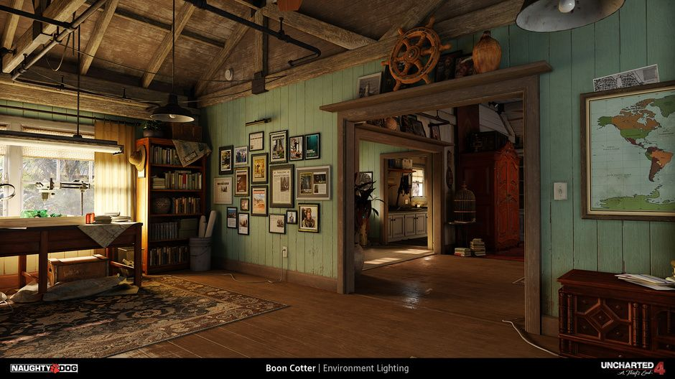
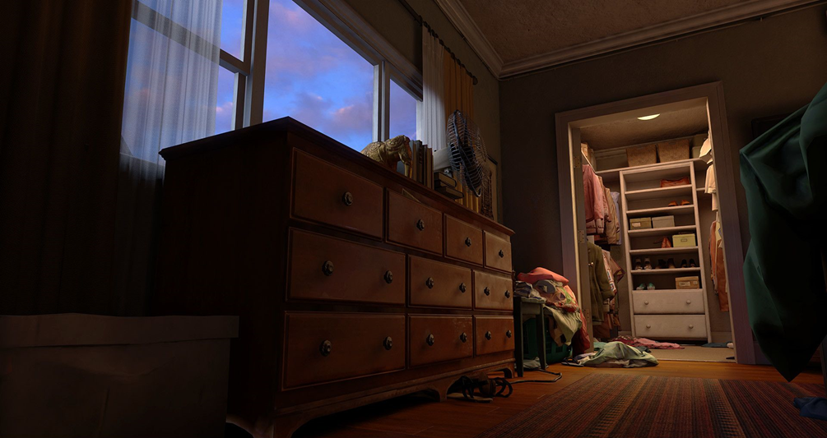
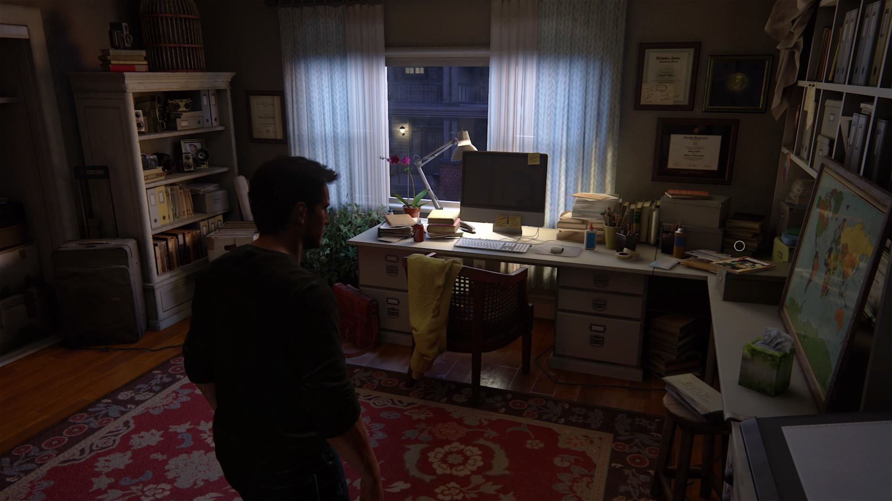
Reference: Uncharted 4
Uncharted 4 is a useful reference in terms of it’s realistic aesthetic. It can be used for both texture reference and assets construction reference.

Slide 10
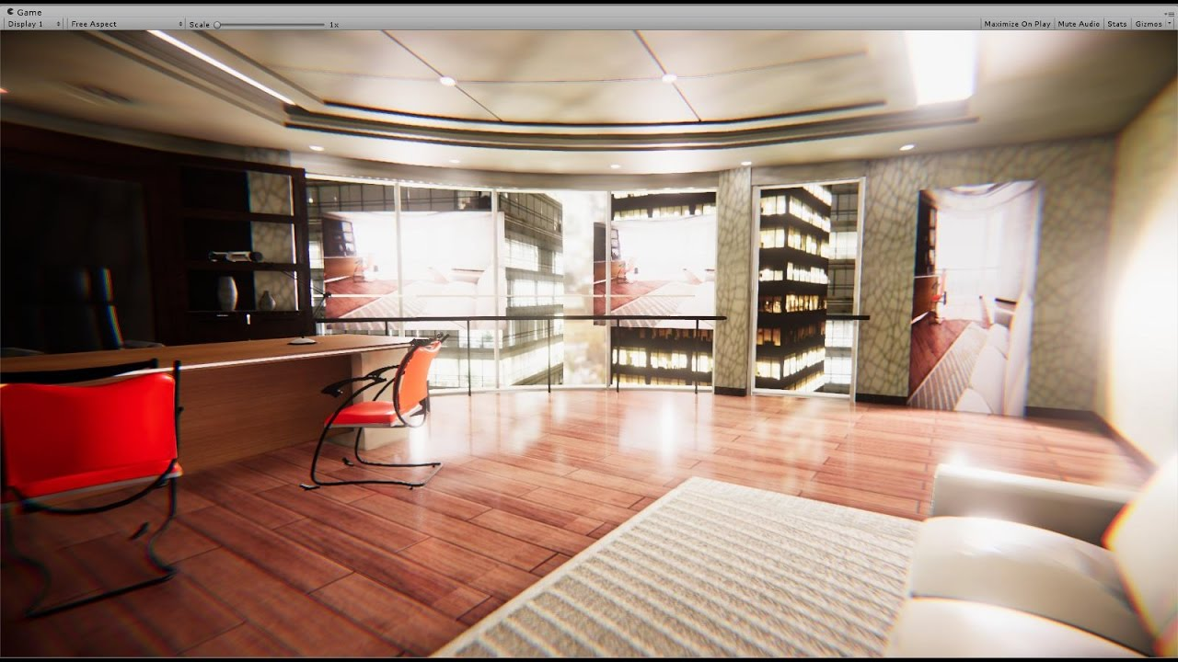
References: Random photos
Here are a couple of pictures that contain valuable art form and modelling/texturing asset information.

Slide 11
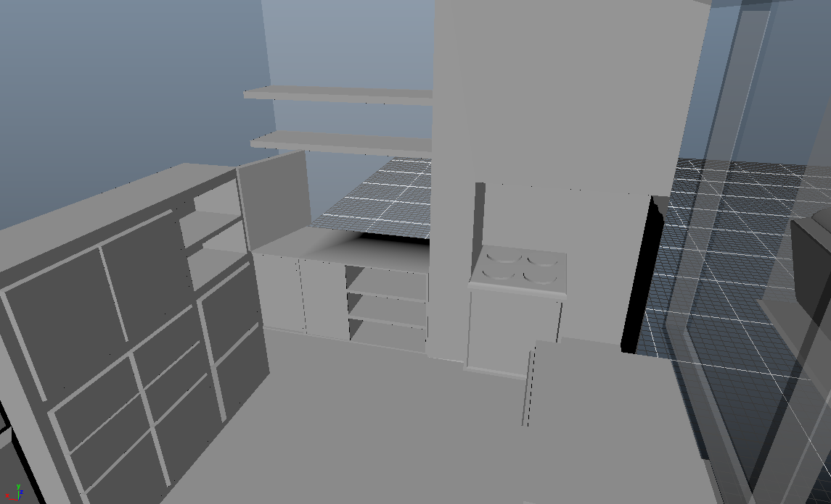
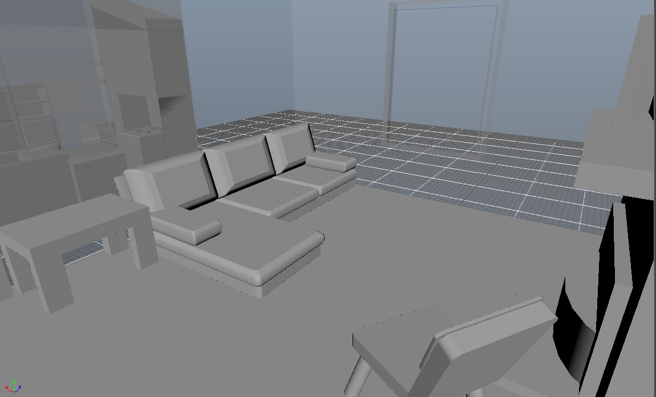
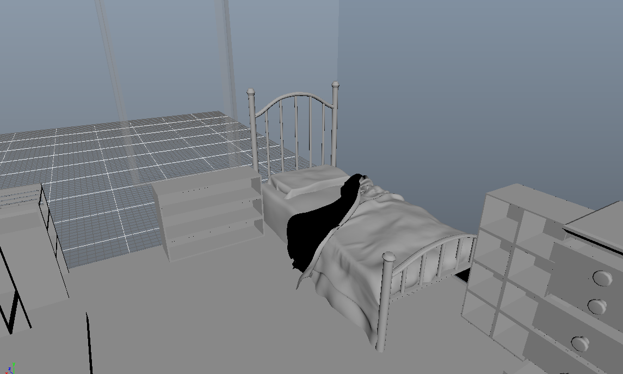
Concepts and Grey Boxes

Slide 12
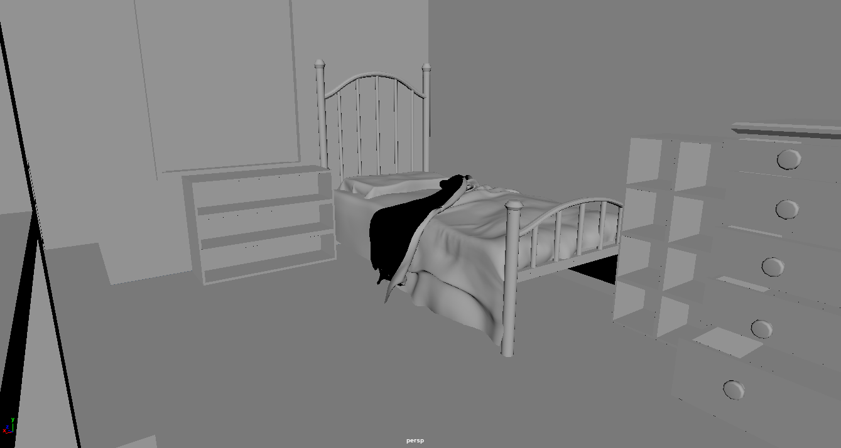
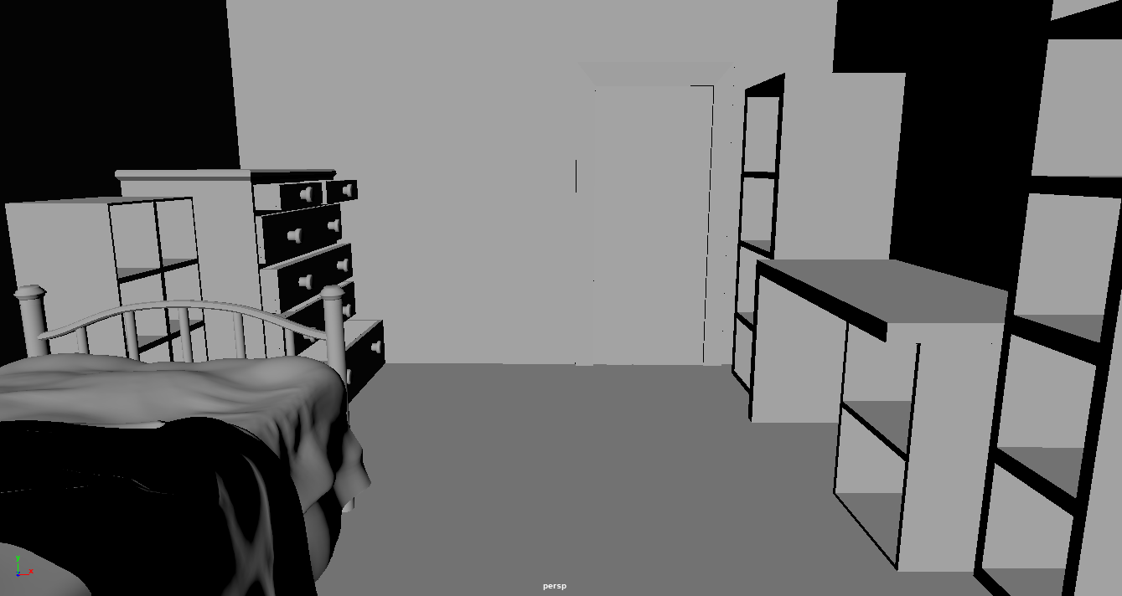
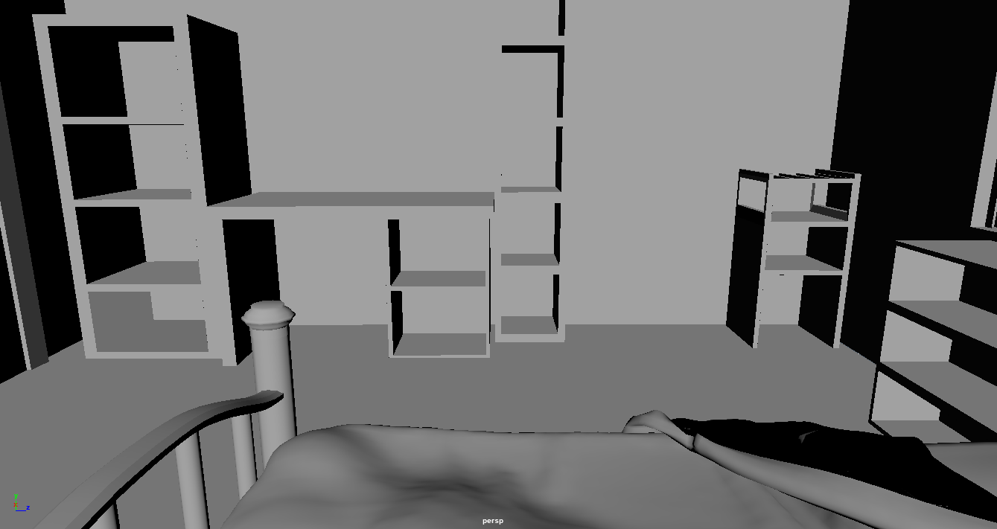
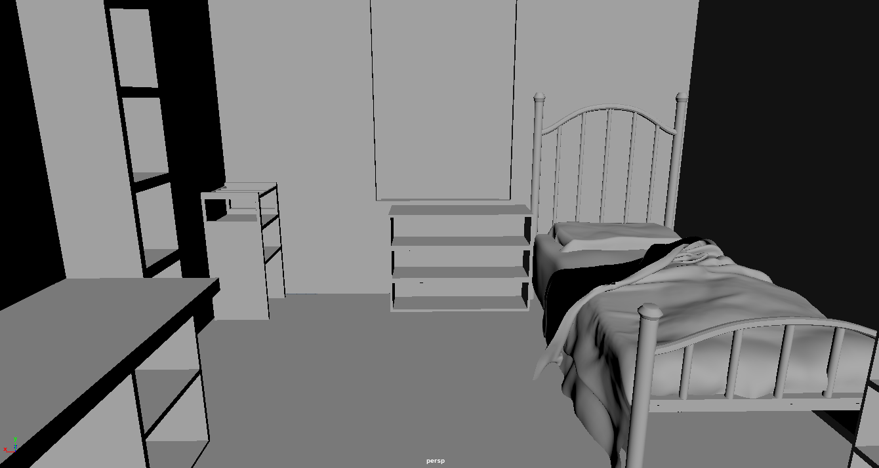
Bedroom Grey Box

Slide 13
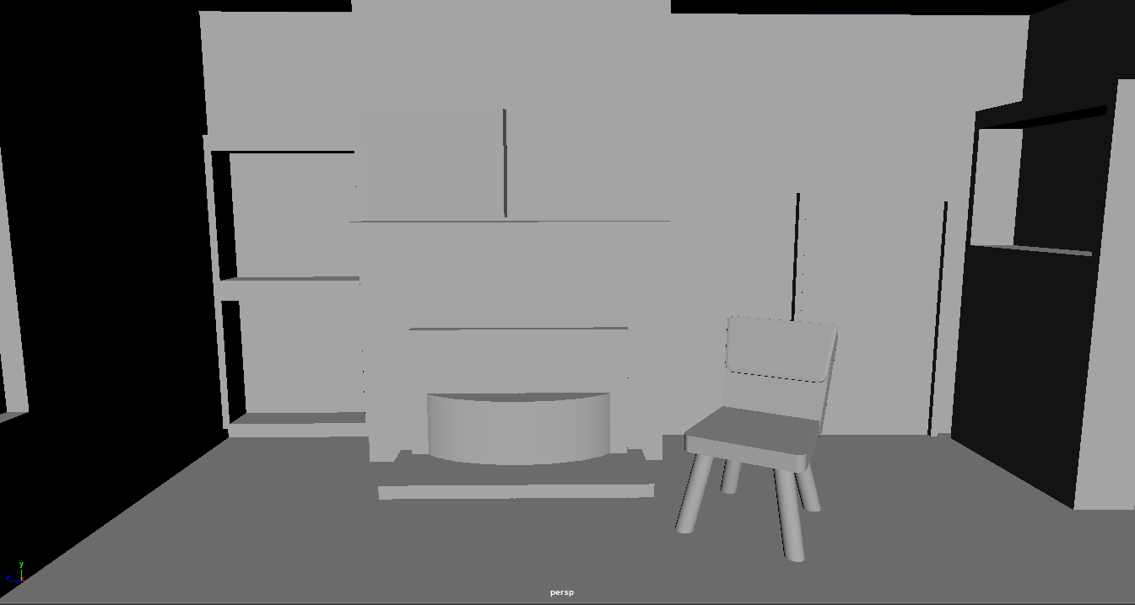
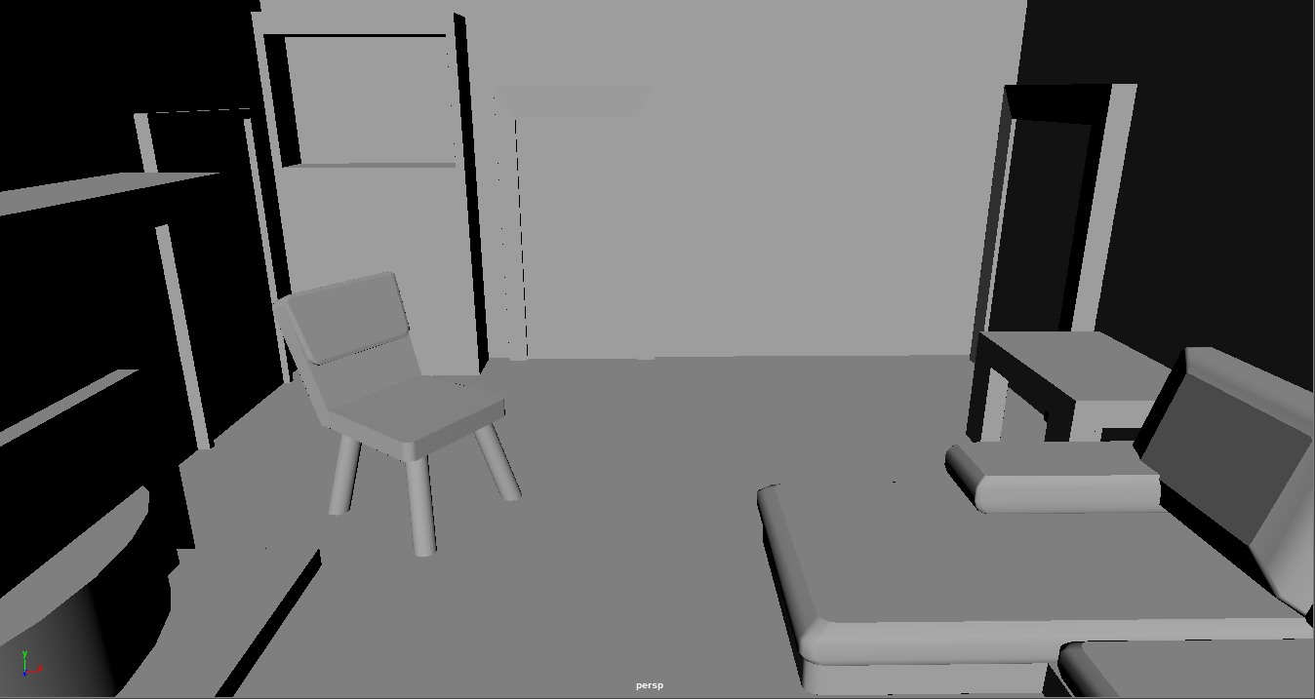
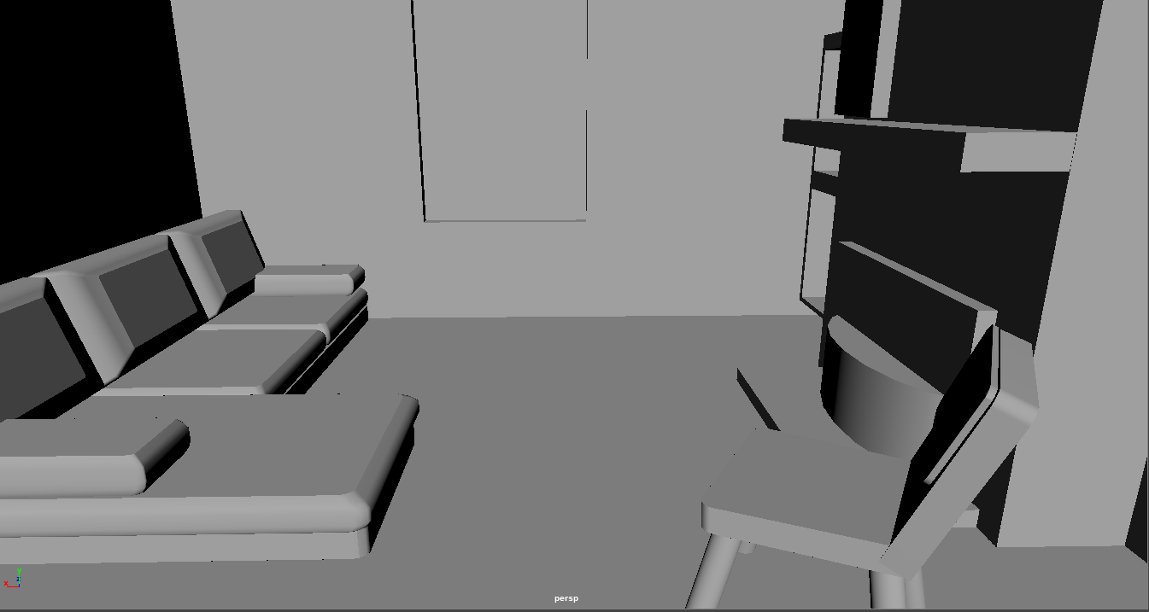
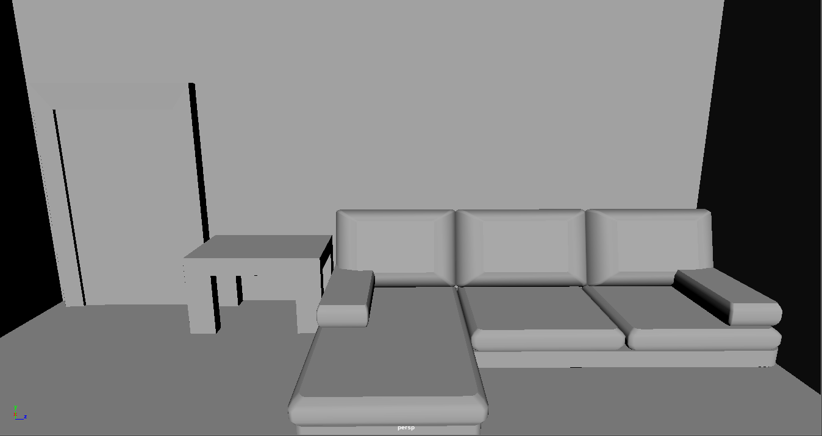
Living Room Grey Box

Slide 14
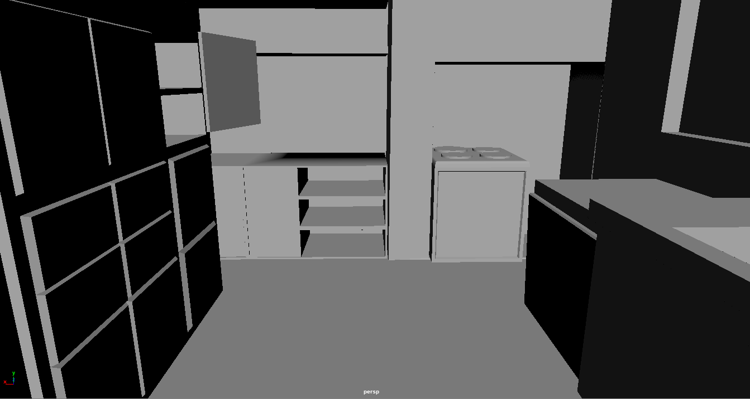
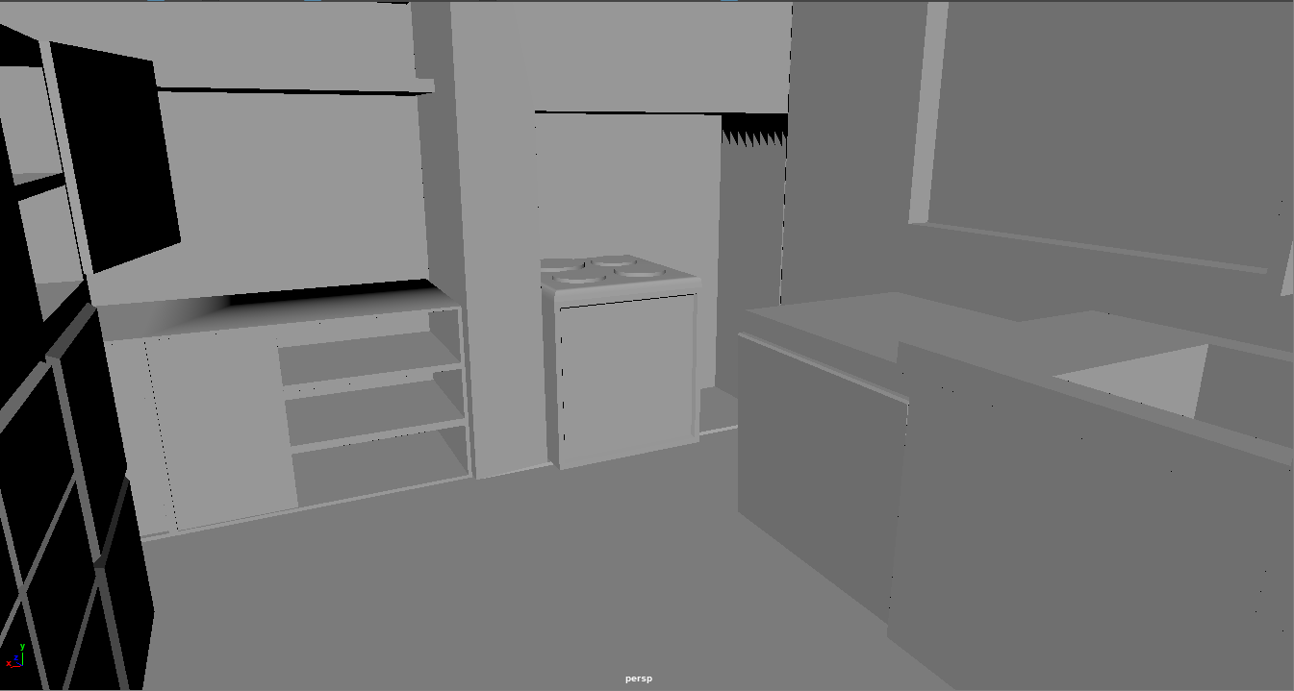
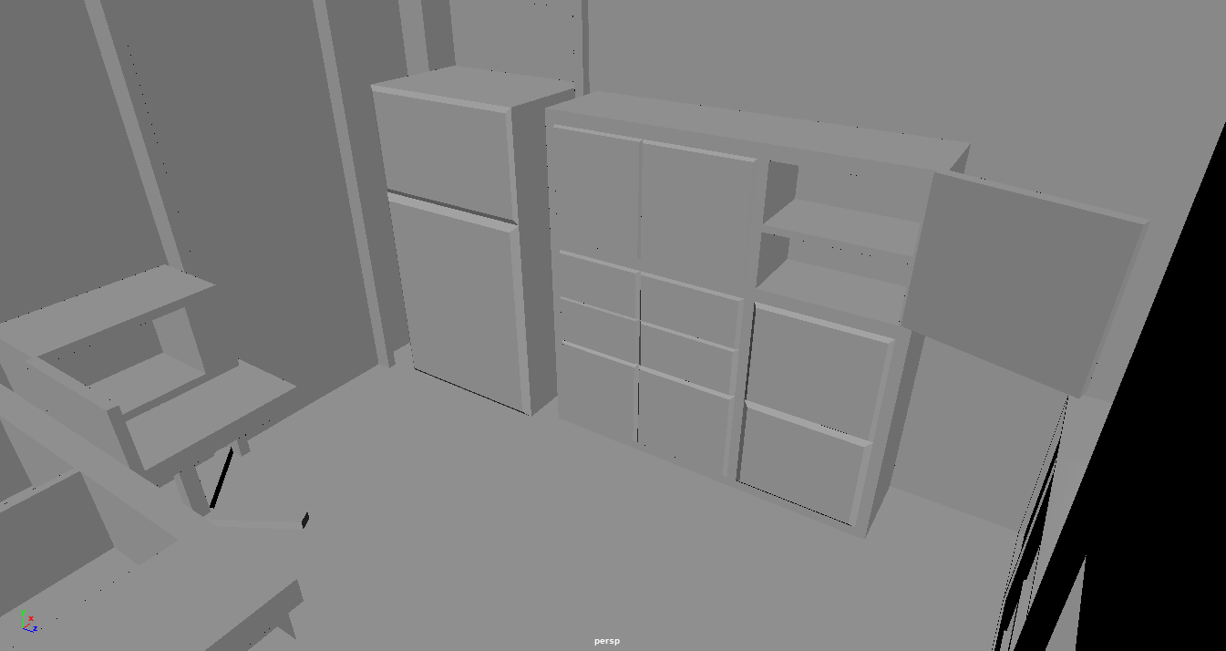
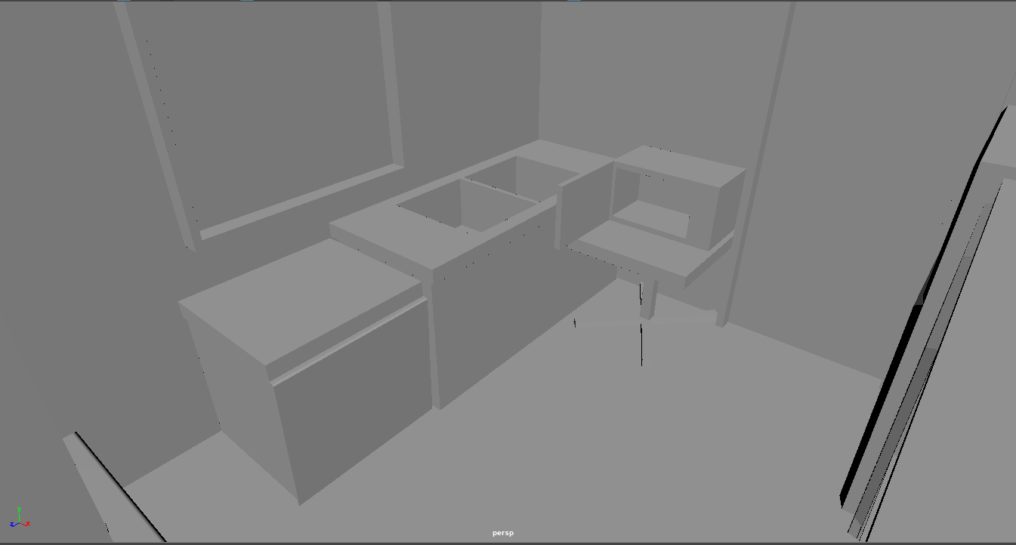
Kitchen Grey Box

Slide 15
Technical Requirements
Software
- Maya
- Substance Painter
- Substance Designer
- Unity
Platforms:
- PC VR & Mobile VR
Poly count: TBD
Texture Resolutions:
- 1024x1024 & 512x512

